Slide 1
Application of Event Sequence CNN Framework on Customer Churn Prediction
Cheng Ji

Slide 2
Agenda
Background
Problem Statement
Data Preparation
Modeling approach
Summary

Slide 3
Background
Client: One of the largest wireless carriers in US
Current solution: Logistic Regression (AUC=0.69)

Slide 4
Background
Motivation:
Current feature pool has around 900 variables, but it still lacks of variety. We have numerical variables covering mainly bill, payment, voice/data usage and some account/plan info.
There is one data we have access but yet to use: Memo data which records a lot of events happened to the customers with timestamp.
Question:
Can we do something with this data to improve our model performance?

Slide 5









Problem Statement: Can we use Memo data to predict churn?
Historical events in the past X months
What’s his next action?
- Churn, AAL or HSU?

Slide 6
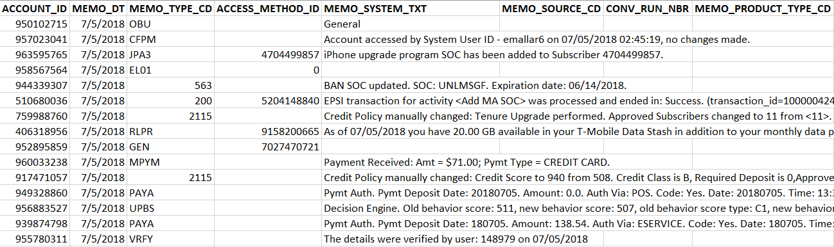
Data Preparation
What does the data look like?

Slide 7
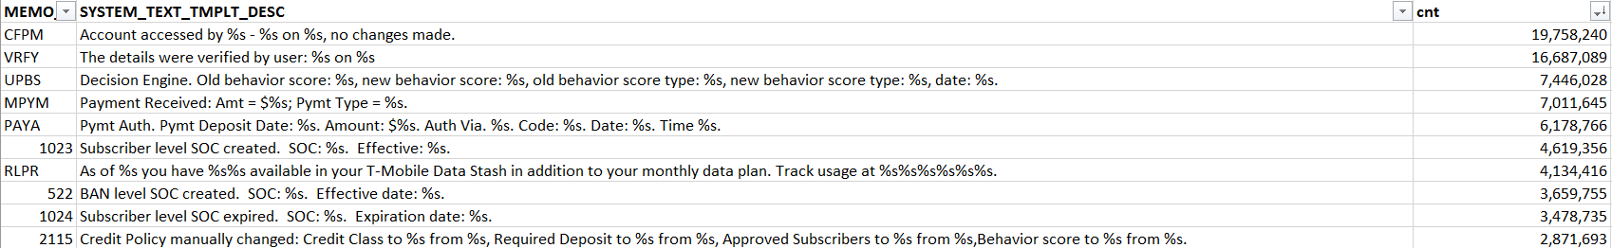
Data Preparation
What does the data look like?
* Based on one month (2018/06) data

Slide 8
Data Preparation
Is there really something worth exploring?
CFPM: Account accessed by User ID - xyz on 07/05/2018 02:45:19, no changes made.
DADD: Discount Plan Added, Eff date:07/05/2018, Exp date:No Expiration, Discount:MEPYDIS - Auto Pay Discount, User:abc

Slide 9

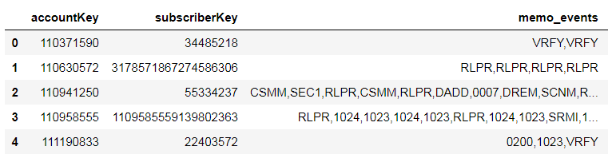
Data Preparation
Solution: concat a customer’s Memo code into a string in the sequence of event time

Slide 10
Data Preparation
Target definition: customers who have “Deactivation” (churn) happens during Day 15 ~ Day 45 after month end.
Target rate: 1.4%

Slide 11
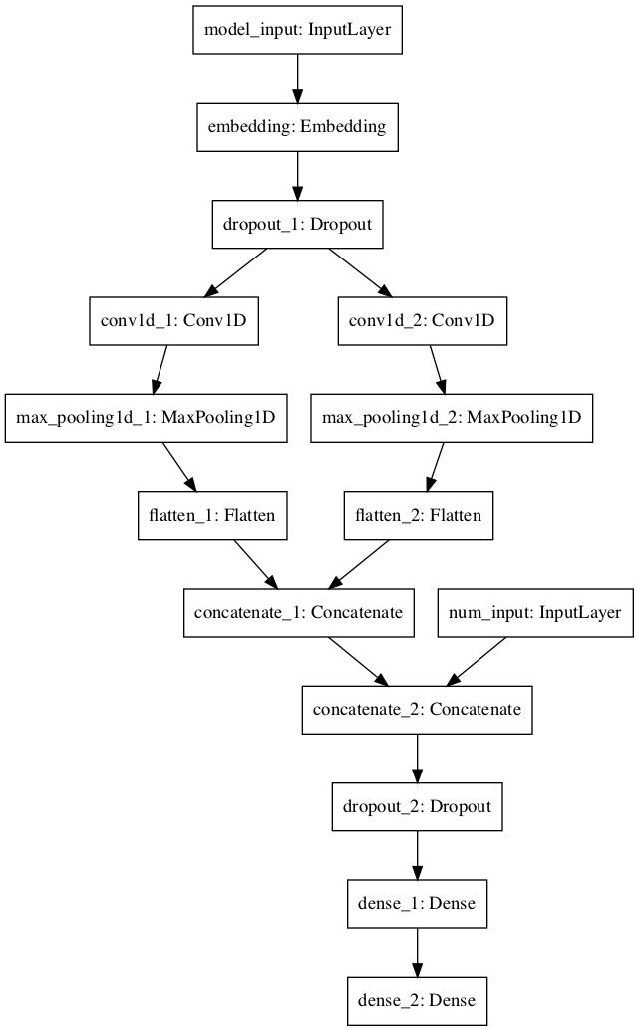
Model Structure
Event sequence
Word2vec layer or CNN embedding?
CNN layer
Adding numerical features?
Fully Connected Layer
Predication Target(Churn)

Slide 12
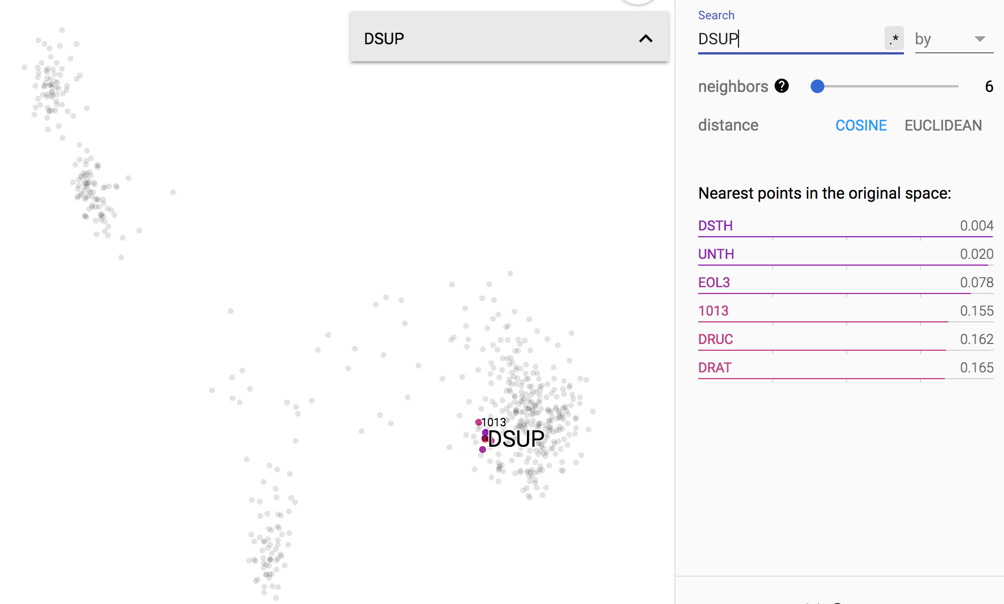
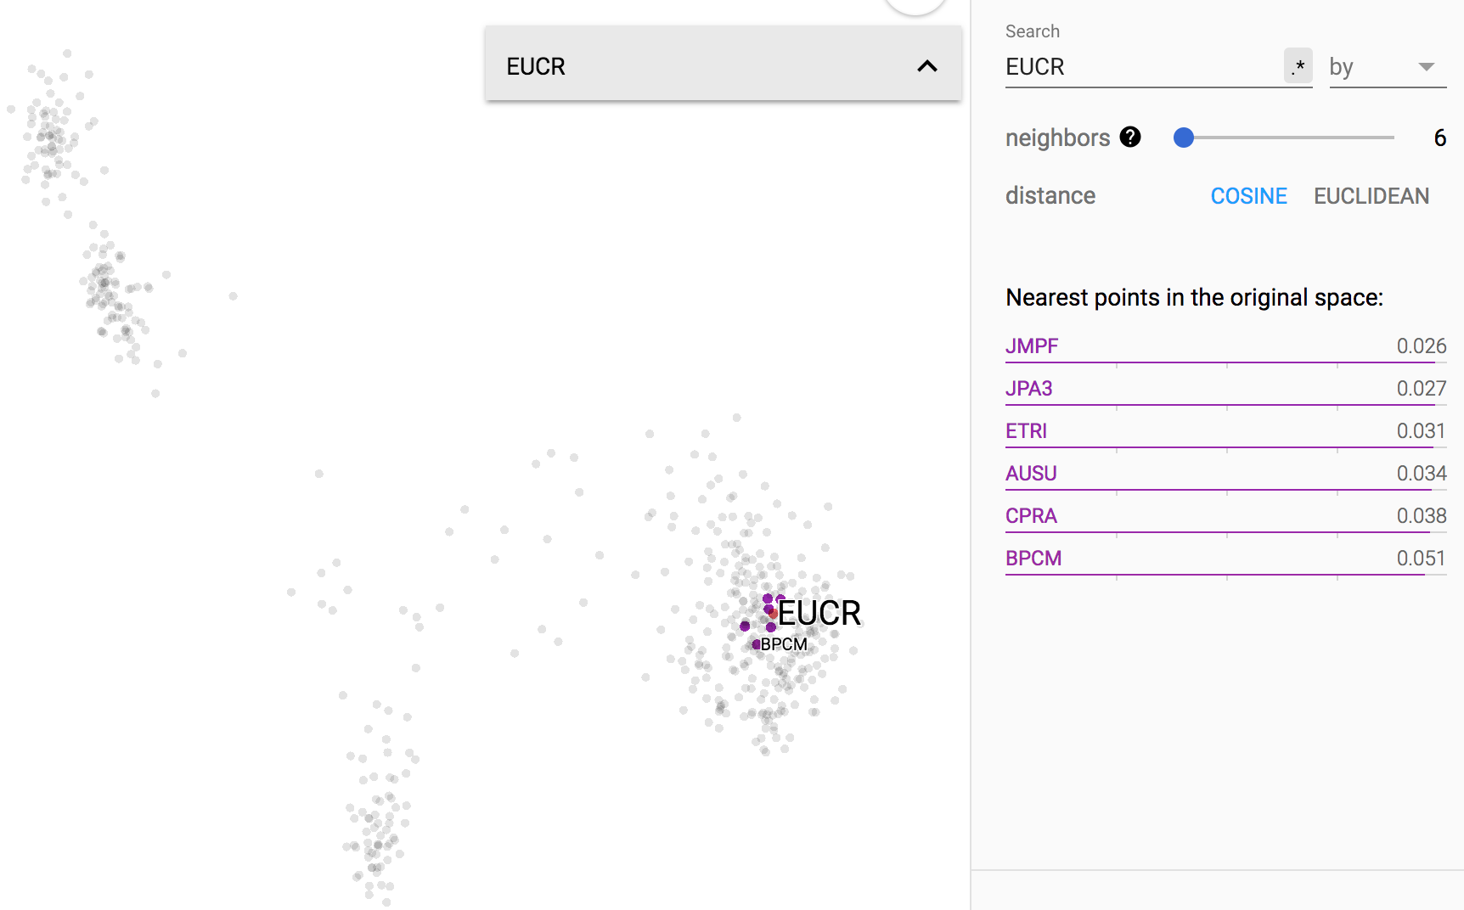
Word2vec based Event Embedding and t-SNE Visualization
Most similar events for ‘DSUP’:
DSUP | Data Up-sell message sent
DSTH | Data Throttle
UNTH | Data Un-Throttle
EOL3 | SMS was sent to customer
1013 | Reactivate Sub. feature
DRUC | Reached 100% Dom roaming
DRAT | XX% of roaming has been used
Most similar events for ‘EUCR’:
EUCR | Customer performed handset upgrade
JMPF | Jump upgrade
JPA3 | iPhone upgrade SOC added
ETRI | Device Trade in Complete
AUSU | Jump tenure reset
CPRA | -
BPCM | Offer response (offer: XX, disposition: XX, reason: xx )

Slide 13
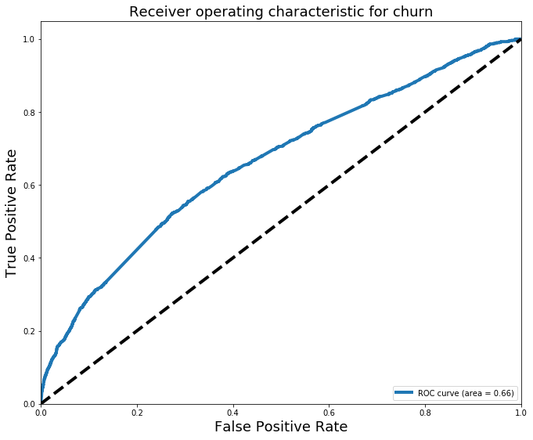
Model approach
First try:

Slide 14
Model Approach
Concern: is there potential target leakage?
0604: Future request. Activity: Cancellation.

Slide 15
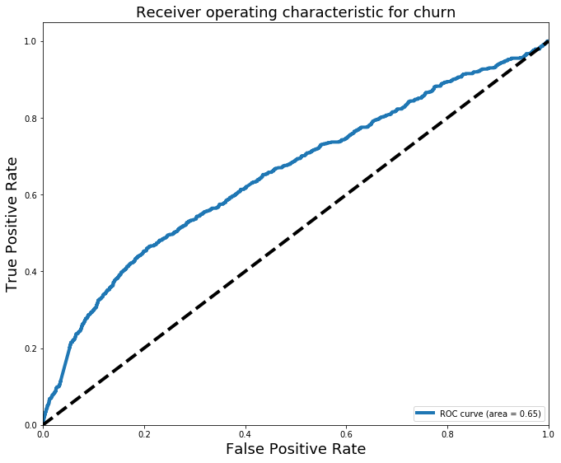
Model approach
After removing o604:

Slide 16
Model Approach
What can we do to improve it?
Data:
How many months do we need to include?
Down sampling?
Model:
Word2vec embedding or not?
Padding length?

Slide 17
Model Approach
What can we do to improve it?
Data:
How many months do we need to include? – 4 months
Down sampling? – 1:2 (most effective)
Model:
Word2vec embedding or not? - no Word2vec
Padding length? - 70

Slide 18
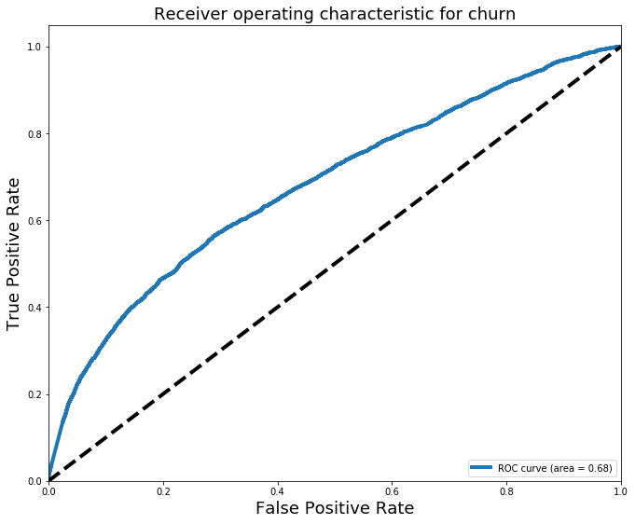
Model approach
Best result with text data only:

Slide 19
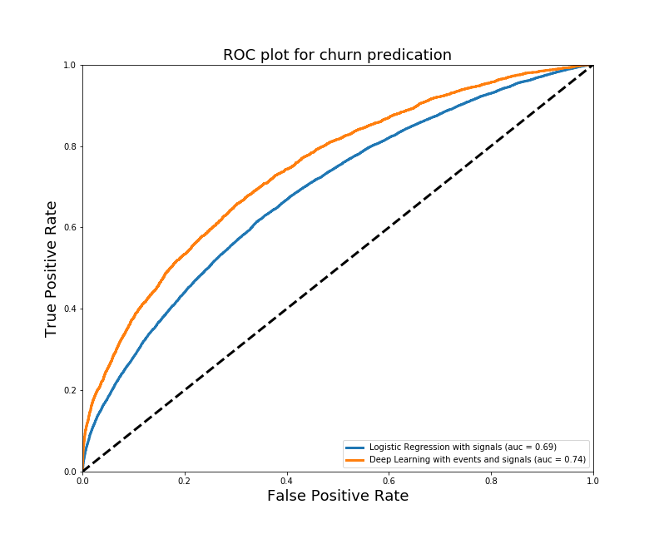
Model approach
Let’s add numerical features:

Slide 20
Summary
What we learn:
We developed an effective event sequence + CNN framework to predict churn.
Data manipulation improves performance significantly, model tuning improves performance marginally.
Next steps:
Campaign sequence?
Apply on different targets

Slide 21
Thank You!
Questions?

